Slide 1
Green Pizza Delivery Services
E-bike delivery Pilot

Slide 2
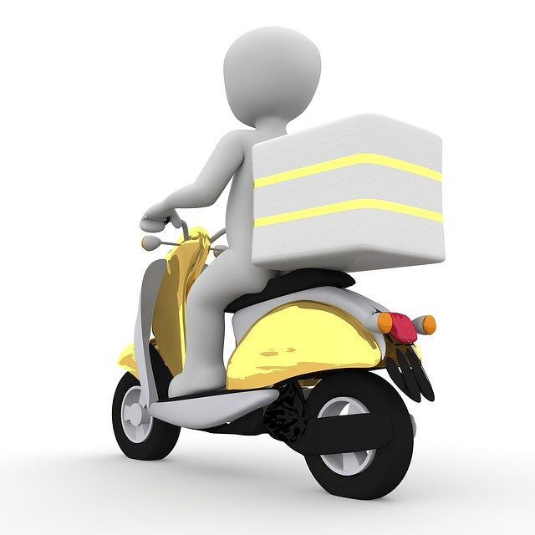

Green Pizza Delivery Services
Startup Company wants to introduce ‘Green Food Delivery Services’ which will use electronic Bikes for delivery.
Focused areas : Urban / Metro
Food Preference Fast Food Like Pizza, additional phases during Pilot will increase additional food categories
Goal : To penetrate food delivery services in urban areas with low cost and less impact on environment with use of electronic bikes. Provide customer service which is competitive than existing players by promising Zero Delivery Fee, Fast ETA and No impact to environment (Ebikes)
Focus of Study :-
Find Pizza places in Downtown Toronto neighborhood for Food partners, Expanding to next food categories like Coffee shops, other restaurants etc.
Find a best mobile Parking slot for ebikes (For charging and parking ebikeswhen not in transit & reachable to all food pickup locations)
Find set of nearby venues for marketing (Onsite, offline – mails / flyers etc)
Pilot Area: Downtown Toronto, CA

Slide 3
Data Collection
Data Description | Source | Processing
Postal Codes of Neighborhoods for Toronto City | https://en.wikipedia.org/wiki/List_of_postal_codes_of_Canada:_M | Perform Webscraping to get postal codes of Toronto & limit dataset to Downtown Toronto
Geolocation for Toronto | https://cocl.us/Geospatial_data Geocoder | Get geolocations using references and geocoder lib based on Postalcodes
Venues/ Places Data for Toronto | https://www3.foursquare.com/products/places-data/?gclid=EAIaIQobChMI2_i5hMr_6AIVxO7jBx2kswAmEAAYASAAEgKqLvD_BwE | Foursquare Places APIs were called to explore and research Downtown Toronto food joins and other venues in area.

Slide 4
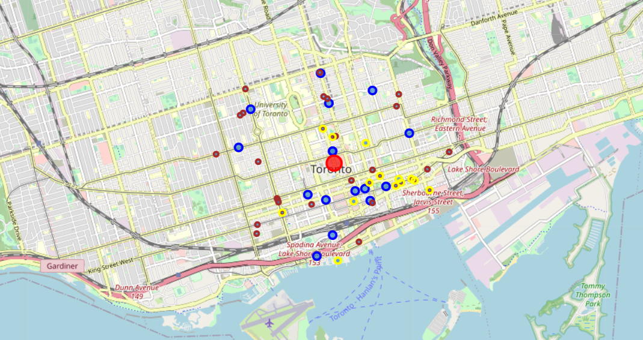
Data Analysis
Data Analysis was performed to identify Pizza places , other food category venues:-
No of Pizza Places : 16
No of Coffee Shops : 31
No of other food joints: 16
Exploratory data analysis was performed through data visualization to understand demographic representation on map for these venues.
Centre for Parking spot for ebike was identified (marked as Red) based on Eucladian distance means, however visualization showed that this is not best method to choose the center as it is not reachable to all food categories in equivalent way.
Potential Parking Center
Pizza places
Coffee Shops
Other

Slide 5
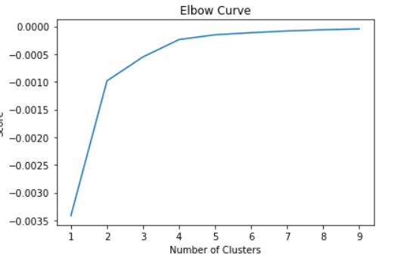
Model Evaluation
K-means Clustering model was performed on data set for all three type of categories of geo-locations to identify how many parking centers and their location will be optimized way of implementing delivery services.
Kmeans Cluster was evaluated using Elbow chart.
When we graph the plot, we see that the graph levels off slowly after 3 clusters. We can use 3 spots as delivery hubs for Downtown Toronto areas.
Three Centers identified are :-
[[ 43.65152214 -79.37102911] [ 43.65178696 -79.39782399] [ 43.6623284 -79.38396404]]

Slide 6
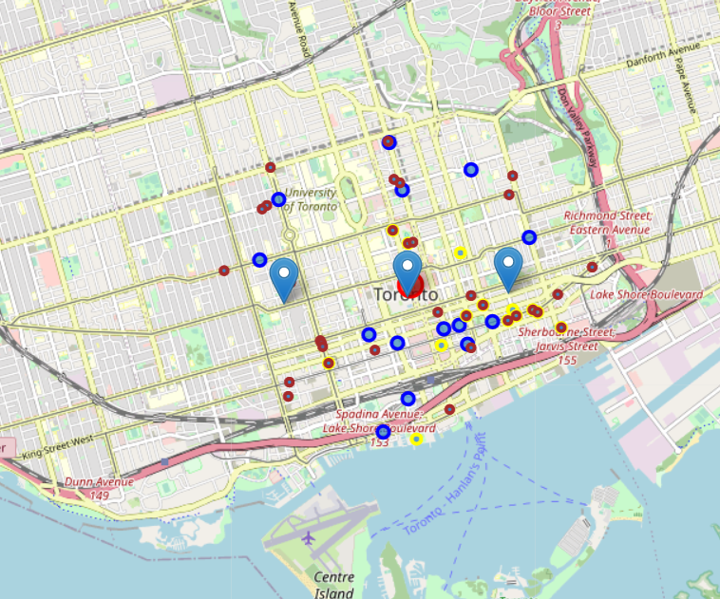
Conclusion
We identified how to implement Green Pizza delivery services pilot in DownTown Toronto area by below findings:-
Pizza Places were identified as food partner in the area for First Phase .
Considering long term vision of expanding these services to food categories beyond Pizza, it was identified that second phase can be inclusion of Coffee shops
After Coffee shops, other restaurants can be considered for third phase
Based on all three phases, it was identified by K means clustering model that if we have to setup multiple Parking spots for ebikes , then what is right number and potential locations of those spots.
Other venues identified like Parks, Gyms , etc can be targeted for localized marketing of Green pizza delivery services
3 Potential Parking areas for Ebikes
Pizza places
Coffee Shops
Other

Slide 7
Future Path & References
Provided we have availability of data, this study can be further be expanded to entire city , other factors can also be included in coming up with Potential Food partners and Parking spots like Restaurant reviews , traffic conditions or orders placed per restaurants.
https://en.wikipedia.org/wiki/List_of_postal_codes_of_Canada:_M
https://en.wikipedia.org/wiki/Food_delivery
https://datascience.stackexchange.com/questions/761/clustering-geo-location-coordinates-lat-long-pairs
Notes:
In Slide Show mode, select the arrows to visit links.

